Slide 1
Layer 3 : Network
IP Address
Subnet mask
Subnetting
IP Address to Mac Address
Routing

Slide 2



Mac Address Table
-------------------------------------------
Mac Address Type Ports
------------------- ------------ -------
000a.41cd.c8c4 DYNAMIC 1
0023.a3bc.c701 DYNAMIC 3
203a.abc2.57a1 DYNAMIC 2
011a.919d.d8a4 DYNAMIC 4
Mac Address Table
-------------------------------------------
Mac Address Type Ports
------------------- ------------ -------
000a.41cd.c8c4 DYNAMIC 1
0023.a3bc.c701 DYNAMIC 3
203a.abc2.57a1 DYNAMIC 2
011a.919d.d8a4 DYNAMIC 4
Mac Address Table
-------------------------------------------
Mac Address Type Ports
------------------- ------------ -------
000a.41cd.c8c4 DYNAMIC 1
0023.a3bc.c701 DYNAMIC 3
203a.abc2.57a1 DYNAMIC 2
011a.919d.d8a4 DYNAMIC 4
E1200-AP
E1200-AP
E1200-AP

Slide 3
Mac Address Table
-------------------------------------------
Mac Address Type Ports
------------------- ------------ -------
000a.41cd.c8c4 DYNAMIC 1
0023.a3bc.c701 DYNAMIC 3
203a.abc2.57a1 DYNAMIC 2
011a.919d.d8a4 DYNAMIC 4
Mac Address Table
-------------------------------------------
Mac Address Type Ports
------------------- ------------ -------
1111a.466d.c764 DYNAMIC 1
0523.12bc.8701 DYNAMIC 3
34ac.abc2.8761 DYNAMIC 2
0234.917d.d874 DYNAMIC 4
Can we build the Internet using ONLY switches and cables
5
5
switch1
switch2
5
5

Slide 4
If only layer-2 devices (switches, WAP) are used to interconnect all the devices on the Internet, it will form 1 single network. The switch tables on every switch will eventually be populated with all the mac addressed of every devices. Any broadcast traffic will be propagated to every switch. This will be a highly inefficient non-scalable solution and therefore not practical to be implement on the Internet
Mac Address Table
-------------------------------------------
Mac Address Type Ports
------------------- ------------ -------
000a.41cd.c8c4 DYNAMIC 1
0023.a3bc.c701 DYNAMIC 3
203a.abc2.57a1 DYNAMIC 2
011a.919d.d8a4 DYNAMIC 4
Mac Address Table
-------------------------------------------
Mac Address Type Ports
------------------- ------------ -------
1111a.466d.c764 DYNAMIC 1
0523.12bc.8701 DYNAMIC 3
34ac.abc2.8761 DYNAMIC 2
0234.917d.d874 DYNAMIC 4
5
5
Mac Address Table
-------------------------------------------
Mac Address Type Ports
------------------- ------------ -------
000a.41cd.c8c4 DYNAMIC 1
0023.a3bc.c701 DYNAMIC 3
203a.abc2.57a1 DYNAMIC 2
011a.919d.d8a4 DYNAMIC 4
Mac Address Table
-------------------------------------------
Mac Address Type Ports
------------------- ------------ -------
000a.41cd.c8c4 DYNAMIC 1
0023.a3bc.c701 DYNAMIC 3
203a.abc2.57a1 DYNAMIC 2
011a.919d.d8a4 DYNAMIC 4
Mac Address Table
-------------------------------------------
Mac Address Type Ports
------------------- ------------ -------
000a.41cd.c8c4 DYNAMIC 1
0023.a3bc.c701 DYNAMIC 3
203a.abc2.57a1 DYNAMIC 2
011a.919d.d8a4 DYNAMIC 4
Mac Address Table
-------------------------------------------
Mac Address Type Ports
------------------- ------------ -------
000a.41cd.c8c4 DYNAMIC 1
0023.a3bc.c701 DYNAMIC 3
203a.abc2.57a1 DYNAMIC 2
011a.919d.d8a4 DYNAMIC 4
Mac Address Table
-------------------------------------------
Mac Address Type Ports
------------------- ------------ -------
000a.41cd.c8c4 DYNAMIC 1
0023.a3bc.c701 DYNAMIC 3
203a.abc2.57a1 DYNAMIC 2
011a.919d.d8a4 DYNAMIC 4

Slide 5
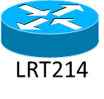
We need Layer-3 devices to interconnect the switches.
Layer 3 is used primarily to :
Provide a logical address space for each network
Control the traffic between networks efficiently
Block the broadcast traffic between networks
Broadcast between networks known as multicast is still possible using multi-cast addresses.
Mac Address Table
-------------------------------------------
Mac Address Type Ports
------------------- ------------ -------
000a.41cd.c8c4 DYNAMIC 1
0023.a3bc.c701 DYNAMIC 3
203a.abc2.57a1 DYNAMIC 2
011a.919d.d8a4 DYNAMIC 4
Mac Address Table
-------------------------------------------
Mac Address Type Ports
------------------- ------------ -------
000a.41cd.c8c4 DYNAMIC 1
0023.a3bc.c701 DYNAMIC 3
203a.abc2.57a1 DYNAMIC 2
011a.919d.d8a4 DYNAMIC 4
Mac Address Table
-------------------------------------------
Mac Address Type Ports
------------------- ------------ -------
000a.41cd.c8c4 DYNAMIC 1
0023.a3bc.c701 DYNAMIC 3
203a.abc2.57a1 DYNAMIC 2
011a.919d.d8a4 DYNAMIC 4
E1200-AP
E1200-AP
E1200-AP

Slide 6
IP Address
Logical unique identifier for layer 3 (Network) devices
IPv4 address, 32 bit vs IPv6 address, 128 bit
192.168.10.100 | fe80::e828:3518:6a86:eef3
IPv4:DOTTED DECIMAL NOTATION
 | 1st Octet | 2nd Octet | 3rd Octet | 4th Octet
DECIMAL | 192. | 168. | 10. | .100
HEXADECIMAL | C0 | A8 | 0A | 64
BINARY | 1100 0000 | 1010 1000 | 0000 1010 | 0110 0100
An IP address has a network id and host id, where the network id identifies a network, and the host identifies a host in that network.

Slide 7
What is Subnet Mask?
Subnet mask is used to identify network id of an IP address by performing this:
IP address
BITWISE
AND
Subnet
mask
Network ID or Address
=
IP address | 192. | 168. | 10. | .100
 | 11000000 | 10101000 | 00001010 | 01100100
Subnet Mask | 255 | 255 | 255 | 0
 | 11111111 | 11111111 | 11111111 | 00000000
Network Address | 192. | 168. | 10. | 0
 | 11000000 | 10101000 | 00001010 | 00000000
Class A | 255. 0. 0. 0 N. H. H. H
Class B | 255. 255. 0. 0 N. N. H. H
Class C | 255. 255. 255. 0 N. N. N. H
Default subnet mask

Slide 8
Class of IP Address
The 5 classes of network : A, B, C, D and E
Class | 1st Octet | 2nd Octet | 3rd Octet | 4th Octet
A | 0NNNNNNN | HHHHHHHH | HHHHHHHH | HHHHHHHH
B | 10NNNNNN | NNNNNNNN | HHHHHHHH | HHHHHHHH
C | 110NNNNN | NNNNNNNN | NNNNNNNN | HHHHHHHH
N – Network bits
H – Host bits
D : MULTICAST ADDRESS (1110 ...)
E: EXPERIMENTAL (1111 ...)
Class | Leading Bits (1st Octet) | Network Bits | Host Bits | Start Address | End Address
A | 0 (0 to 127) | 7 | 24 | 0.0.0.0 | 127.255.255.255
B | 10 (128 to 191) | 14 | 16 | 128.0.0.0 | 191.255.255.255
C | 110 (192 to 223) | 21 | 8 | 192.0.0.0 | 223.255.255.255

Slide 9
Class | Number of Networks | Number of Hosts in Network
A | 2⁷ = 128 | 2²⁴ – 2 = 16,777,214
B | 2¹⁴ = 16,384 | 2¹⁶ – 2 = 65,534
C | 2²¹ = 2,097,152 | 2⁸ – 2 = 254
INTERNET
A
10.0.0.0/255.0.0.0
B
132.1.0.0/
255.255.0.0
C
199.19.2.0/
255.255.255.0
C
199.19.1.0/
255.255.255.0
A
20.0.0.0/255.0.0.0
C
200.20.1.0/
255.255.255.0
A
11.0.0.0/255.0.0.0
C
200.19.2.0/
255.255.255.0
B
132.2.0.0/
255.255.0.0

Slide 10
IANA (Internet Assigned Number Authority)
IANA
Backbone ISP
Backbone ISP
Regional ISP
Regional ISP
Large Private Organisation
Local ISP
Local ISP
Local ISP
Local ISP
END USERS
END USERS
END USERS

Slide 11
Subnetting
partition a class C network into smaller networks
192.168.10.0
Network Address | 11000000 | 10101000 | 00001010 | 00000000
192.168.10.00000001
(192.168.10.1)
to
192.168.10.01111111
(192.168.10.127)
25 BIT SUBNET MASK
255.255.255.128
192.168.10000000
(192.168.10.128)
to
192.168.11111110
(192.168.10.254)

Slide 12
Subnetting
INTERNET
ISP Network: 10.0.0.0/255.0.0.0
Customer B
10.3.0.0/255.255.0.0
(65,534 hosts)
Customer A
10.1.0.0/255.255.0.0
(65,534 hosts)
Customer B
10.2.0.0/255.255.0.0
(65,534 hosts)

Slide 13
LAN
E1200-AP
E1200-AP
E1200-AP
SSID | GRP10
IP address range: | 192.168.10.100 to 192.168.10.150
Subnet Mask: | 255.255.255.0
SSID | GRP20
IP address range: | 192.168.20.100 to 192.168.20.150
Subnet Mask: | 255.255.255.0
SSID | GRP30
IP address range: | 192.168.30.100 to 192.168.30.150
Subnet Mask: | 255.255.255.0

Slide 14
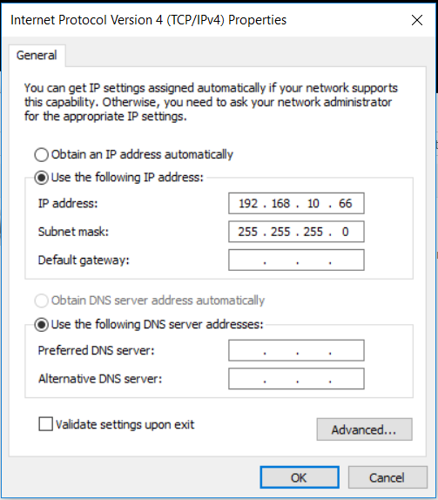
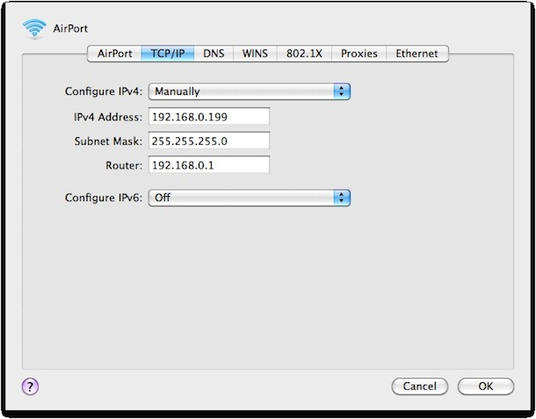

Slide 15
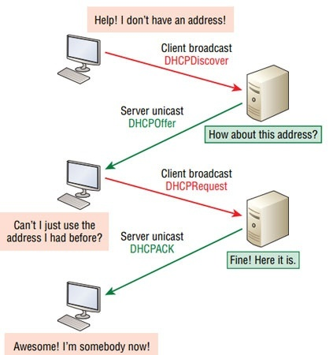
Dynamic Host Configuration Protocol(DHCP) Service
usually provided by a router
client uses a data-link layer (MAC) broadcast address
configure a range of IP addresses and a subnet mask to issue to clients
IP addresses are not permanent, their leased period will expired and will need to be renewel

Slide 16
NETWORK: 15.0.0.0/24
NETWORK: 192.168.10.0/24
NETWORK: 192.168.20.0/24
NETWORK: 192.168.30.0/24
E1200-AP
E1200-AP
E1200-AP
SSID | GRP10
IP address range: | 192.168.10.200 to 192.168.10.210
Subnet Mask: | 255.255.255.0
D/F Gateway | 192.168.10.2
SSID | GRP20
IP address range: | 192.168.20.200 to 192.168.20.210
Subnet Mask: | 255.255.255.0
D/F Gateway | 192.168.20.2
SSID | GRP30
IP address range: | 192.168.30.200 to 192.168.30.210
Subnet Mask: | 255.255.255.0
D/F Gateway | 192.168.30.2

Slide 17

Routers
at least 2 network interface to connect to 2 or more networks
Routes
115.0.0.0/
255.255.255.0
DESTINATION:
192.168.20.0/255.255.255.0
HOW:
FROM: WAN/IF FORWARD TO
15.0.0.20 (DEFAULT GATEWAY)
HOP COUNT: 2
WAN I/F: 15.0.0.10
WAN I/F: 15.0.0.20
Router A
LAN I/F:192.168.10.254
1
2
Router B
192.168.10.0/
255.2255.255.0
LAN I/F:192.168.20.254
192.168.20.0/
255.255.255.0

Slide 18
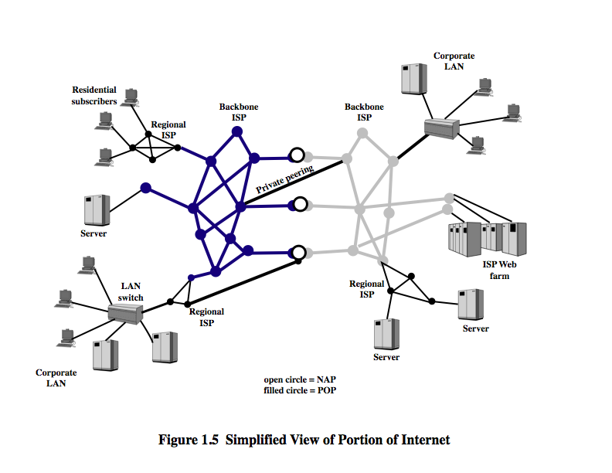
Routing
Selecting the next hop to reach the destination
Based on information in the routing table of layer 3 (Network) devices
Routers exchanged route entries using routing protocols Eg RIP (Routing Information Protocol),
OSPF (Open Shortest Path First)
https://youtu.be/zeArDrC2xPg

Slide 19
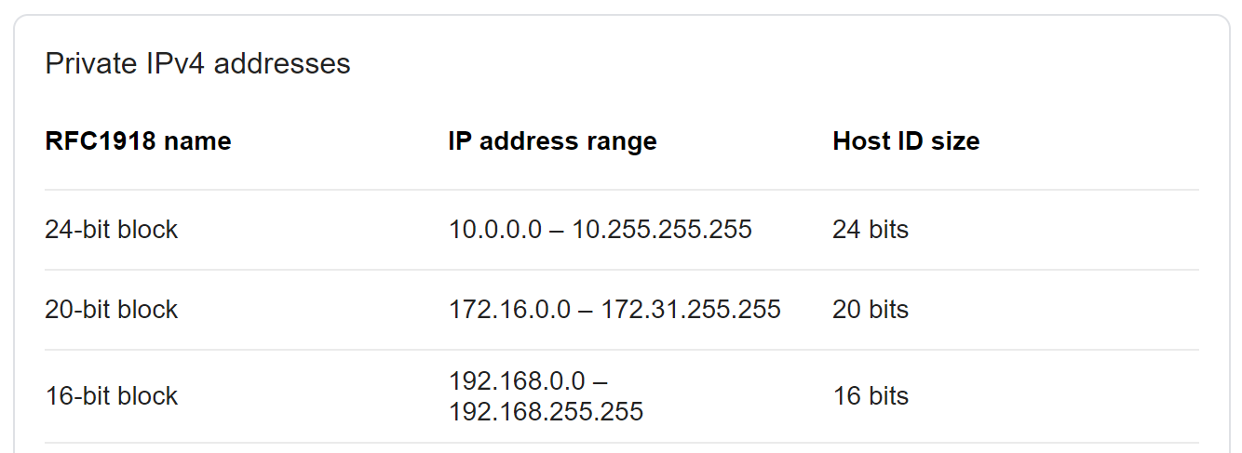
Private Addresses
These addresses are not visible on the Internet. They are blocked by the Internet routers
1 Class A network
16 Class B networks
256 Class C networks
169.254.0.0/16

Slide 20
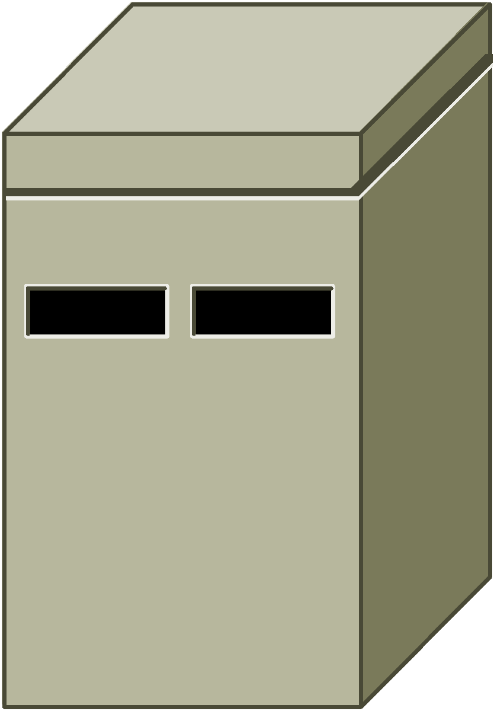
Network Address Translation (NAT)
216.239.38.120
1Internet
192.168.10.0/24
192.168.10.2
15.0.0.1
Router
16.0.0.1
192.168.10.2
192.168.10.0/24
Router

Slide 21
Network Address Translation (NAT)
216.239.38.120:80
192.168.10.200:54321
1Internet
192.168.10.2
192.168.10./24
15.0.0.1
Router
203.0.113.5:56789
Original
Translated
Original
Translated
Type
192.168.10.210:12345
Source IP:Port
Source IP:Port
Destination
Destination
IP:Port
IP:Port
192.168.10.200:
15.0.0.1:
216.239.38.120:
216.239.38.120:
Source NAT
54321
20345
80
80
192.168.10.210:
15.0.0.1:
216.239.38.120:
216.239.38.120:
Source NAT
12345
33456
80
80
203.0.113.5:
203.0.113.5:
15.0.0.1:
192.168.10.200:
Destination NAT
56789
56789
443
443
192.168.10.200:443

Slide 22


Address Resolution Protocol
ARP
Application
(socket)
Destination:192.168.10.100
ARP CACHE
00F48DD679C6 | 192.168.10.100
ARP CACHE
00F48DD679C6 | 192.168.10.100
BROADCAST TO FF:FF:FF:FF:FF:FF
WHO IS 192.168.10.100
ONLY UNDERSTAND MAC ADDRESSES
SWITCH
BROADCAST TO FF:FF:FF:FF:FF:FF
I AM 192.168.10.100
MY MAC ADDRESS IS
00-F4-8D-D6-79-C6
Router
ARP CACHE
00F48DD679C6 | 192.168.10.100

Slide 23
Summary of Protocols
Layer | Protocols |  | Addressing
Network | NAT | Translate Private IP Address to Public IP Address and vice versa | IP addresses
 | DHCP | Assigned IP addresses to computers on the network
 | RIP/OSPF (Routing) | Update routing information between routers
Datalink | ARP | Resolve IP addresses to MAC addresses | BROADCAST
 | Ethernet/IEEE 802.3 | Forward data frames based on MAC addresses | MAC Addresses

